Slide 1
CMPE 202 Project Presentation
Presented by: Pirates(Blue Alliance)
Team Members:
Name | CMPE 202 Section Number | SJSU ID
Aditya Parashar | 03 | 011440195
Amruta Dhondage | 04 | 011416210
Arpita Dixit | 04 | 010953267
Chaya Malik | 04 | 010902112
Jay Nirgudkar | 03 | 011440325

Slide 2
CS Unplugged Activity Chosen
We chose demonstrating the concept of Finite State Automata through the treasure hunt game developed by our team
Link to the CS Unplugged Activity: http://csunplugged.org/finite-state-automata/

Slide 3
FSA
A finite-state machine (FSM) or finite-state automaton (FSA, plural: automata), or simply a state machine, is a mathematical model of computation used to design both computer programs and sequential logic circuits. It is conceived as an abstract machine that can be in one of a finite number of states.
(Source for above: Wikipedia)

Slide 4
The game .. Treasure hunt..
The game aims to find out a hidden treasure.
The player has to cross seven levels to reach the place where the hidden treasure is.
Crossing a level involves crossing hurdles and giving correct answers to the hints that come up.
Finally on reaching the place where the treasure is hidden, the player has to cross the hurdles to grab the treasure.
Hurdles in the game involves killing sharks and skeletons.
The game is a multiplayer game, the first player to grab the treasure is the winner.

Slide 5
UML DIAGRAMS

Slide 6
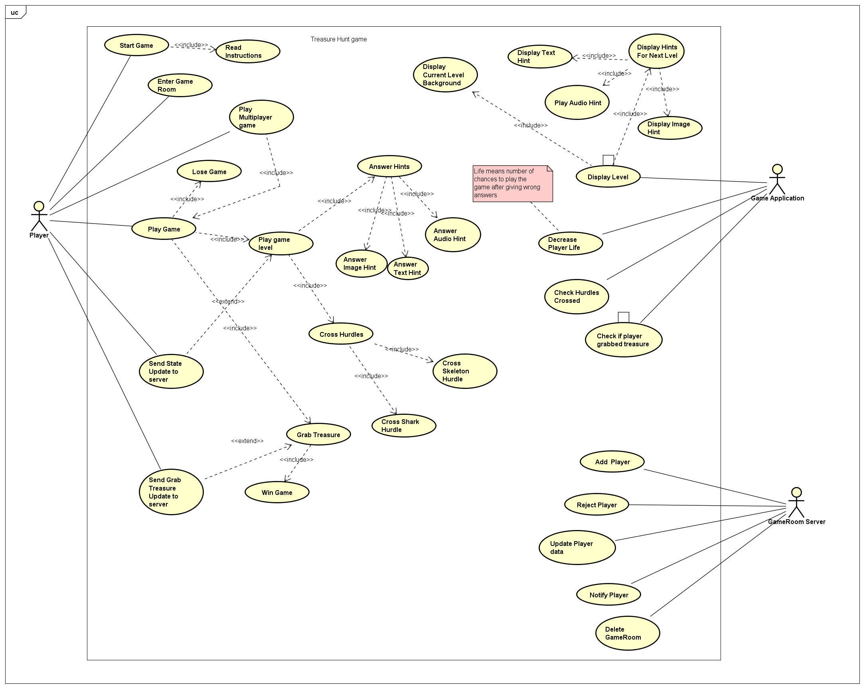
USE CASE DIAGRAM
The diagram to the right is the use case diagram for the treasure hunt game developed by our team

Slide 7
Use Case Description for Use Case: Play Game
Use Case Name: Play Game
Brief Description: Player plays the treasure hunt game
Actors: Player
Basic Flow of Events: Player correctly answers the type of hints that come up in a level of the game. Player moves through all the levels, reaches the final level. Player grabs the treasure and wins the game.
Alternate Flows: 1.a. Player gives wrong answers for the hints for a stage and loses life. 1.b. If player life count reduces to zero, player loses the game. 2.a. Player encounters hurdles and crosses hurdles to go to next level. 2.b. Player encounters hurdles and is not able to cross hurdles to go to next level, loses game. 3.a. Player is not able to grab the treasure and loses the game.
Preconditions: Player has installed the game Player count is five and game has been deployed on server Player has installed the game Player has pressed the start button
Success Guarantee: Player has won the game
Minimal Guarantee: Player has lost the game

Slide 8
Class Diagram
Class Diagram_patterns.asta
The diagram to the right is the class diagram for the treasure hunt game developed by our team

Slide 9
Sequence Diagram
Sequence Diagram1.asta
The diagram to the right is the sequence diagram for the treasure hunt game developed by our team

Slide 10
Activity Diagram
The diagram to the right is the activity diagram for the treasure hunt game developed by our team

Slide 11
Design Patterns Implemented
State
Factory Method
Proxy
Adapter
Observer

Slide 12
Links to Team's Final Task Board
Links to Team's Final Sprint Burndown Chart.
https://docs.google.com/spreadsheets/d/1pBg7BjI20m-MmzSFEvno4B1U5fMI4zQ8l0AFtSaoFr8/edit#gid=0

